Slide 1

DANIEL PARK ★ ANGEL VO ★ ADITYA BAGCHI
TRELLO PROJECT MANAGEMENT
FALL 2021 CAPSTONE PROJECT: CENTER OF EXCELLENCE
SPONSOR: JUSTYNA GRINHOLC

Slide 2
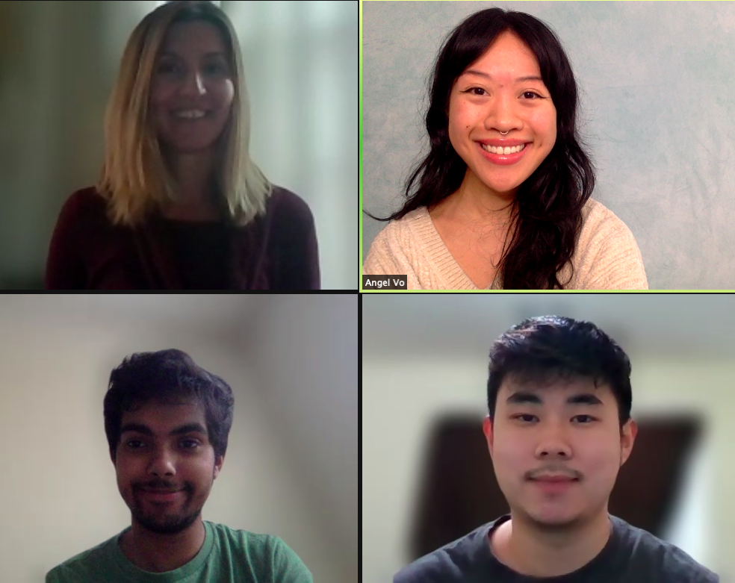
TABLE OF CONTENTS
PROBLEM
01
What is the problem we are trying to solve?
SOLUTION
02
What solution did our team implement and evaluate?
STRATEGY
03
How did we achieve our project goals?
OUTCOME
04
How did we contribute to the program success?
REFLECTION
05
What valuable lessons did we learn?
Our Sponsor (Justyna Grinholc) + Team (Angel Vo, Aditya Bagchi, Daniel Park)

Slide 3
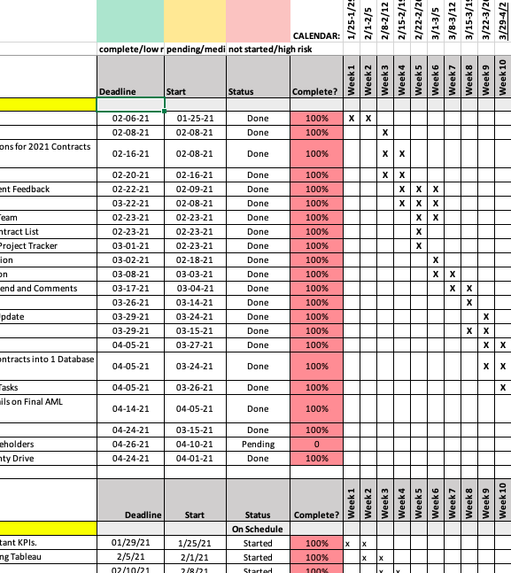
PROBLEM STATEMENT
Each Capstone team's progress was tracked by a large Excel file and Google Sheets with differing locations, file names, and file formats, which required a lot of time and maintenance.
The program needed automation and integration to keep track with its growing success.
Notes:
********Need for automation, integration….
Contributing to existing data
This is the center of excellence Tableau dashboard that justyna maintains (ADD SLIDE, SCREENSHOT)

Slide 4
HIGH-LEVEL PROBLEM OVERVIEW
GROWING PROGRAM SIZE → HIGHER RISK OF INFORMATION ASSYMETRY
REPRESENTATION ⎯ CHANNELS OF COMMUNICATION
CAPSTONE TEAMS
CAPSTONE TEAMS
CAPSTONE TEAMS
CAPSTONE TEAMS
CAPSTONE TEAMS
40 INTERNS
PROJECT SPONSOR(S)
PROJECT SPONSOR(S)
PROJECT SPONSOR(S)
PROJECT SPONSOR(S)
17 TEAMS
23 SPONSORS
MANAGEMENT ANALYSTS
PROGRAM DIRECTOR
PROGRAM ASSISTANT
JUSTYNA GRINHOLC

Slide 5
REQUIREMENTS ANALYSIS
What functional requirements did we consider?
CONDENSE
COMMUNICATION
TIME
EFFICIENCY
DATA INTEGRATION
Streamlining channels of communication for easy monitoring
Saving time and labor by decreasing rework from data loss.
Contributing to the existing database to track program metrics.

Slide 6
TEAM PROJECT SOLUTION
What solution did we implement and evaluate?
STRUCTURED TRACKING
DATA CONSISTENCY
TRAINING SESSIONS
Integrating all progress monitoring into one system
Single naming convention, file storage, and schema.
Coordinated, organized, and implemented one-on-one Trello training

Slide 7
PROJECT GOALS
WHAT DID WE WANT TO ACHIEVE?
PRODUCTIVITY
ORGANIZATION
Enhancing overall program strategy and performance.
We aimed to organize the data more effectively .
SAVING TIME
DOCUMENTATION
Minimizing the amount of time spent tracking project progress.
Guidelines were created to demonstrate future use.
EFFICIENCY
DEMONSTRATION
Best practices were established and documented.
Offering guidance and working sessions to evaluate Trello usage

Slide 8
STRATEGY | PROJECT PLAN OVERVIEW
How did our team plan for success?
INITIATION &
CONCEPTION
PLANNING
LAUNCH &
EXECUTION
MONITORING
& CONTROL
PROJECT
CLOSURE
Define Project Goals
Team Roles
One-on-One Meetings
Maintaining Efficiency
Retrospective Meeting
Create Project Plan
Deadlines
Exporting Trello Data
Quality of Deliverables
Final Documentation
Project Scope
Communication Plan
Status Reports
Team Performance
Celebrate
Milestones

Slide 9
PROCESS SUMMARY
OBJECTIVE: ENHANCING PROGRAM ACHIEVEMENT + DATA INTEGRATION WITH TRELLO
1 ⎯ STRATEGY REFINEMENT
Requirements Analysis Individual Roles Delegation
Capstone Teams Trello Training
Team Coordination
2 ⎯ DATA COLLECTION
Qualtrics Survey Distribution
Trello Sponsor Demonstrations Monitoring Trello Usage & Efficiency
Export Trello Data
Survey User Satisfaction
3 ⎯ DATA PROCESSING
Cybersecurity Risk Analysis
Mitigating Engagement Challenges
Existing Capstone Data Interpretation
Parse New Data
Review COE Data
Analyze Metrics
4 ⎯ RESULTS EVALUATION
Updating Existing COE Data Data Integration from Google Sheets
Publishing Official COE Trello Training Manual
Contribute to Database
Interpret Insights

Slide 10
MAJOR PROJECT PROCESSES
MAJOR PROJECT TASKS → DIVIDED INTO SMALLER SUBTASKS
1
3
2
4
PLANNING
COORDINATING
Developing a structured project plan to solve the problem
Organizing meetings to train sponsors and students
STRATEGIZING
DOCUMENTING
Delegating tasks and deliverables effectively
Creating a training and best practices guide

Slide 11
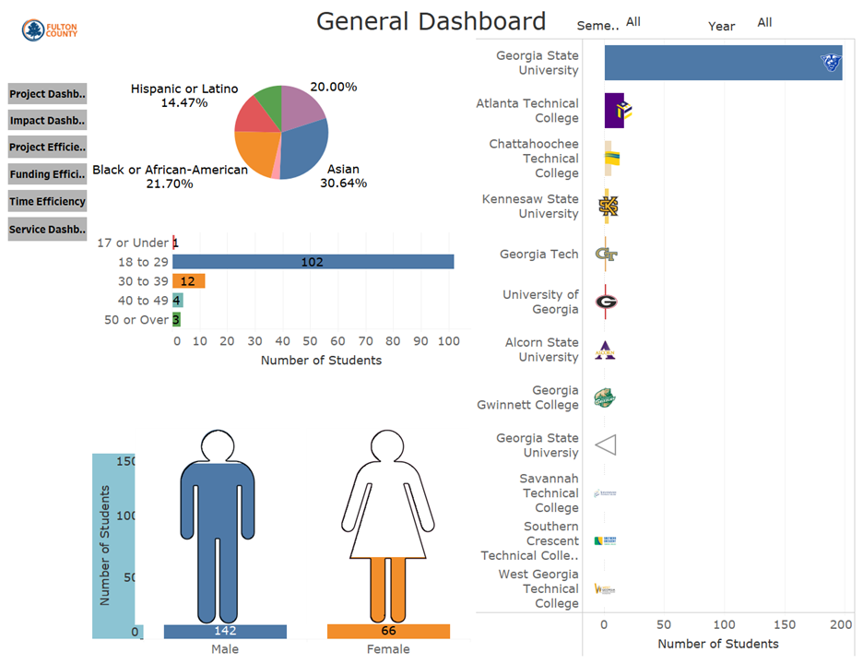
Data Visualization

Slide 12
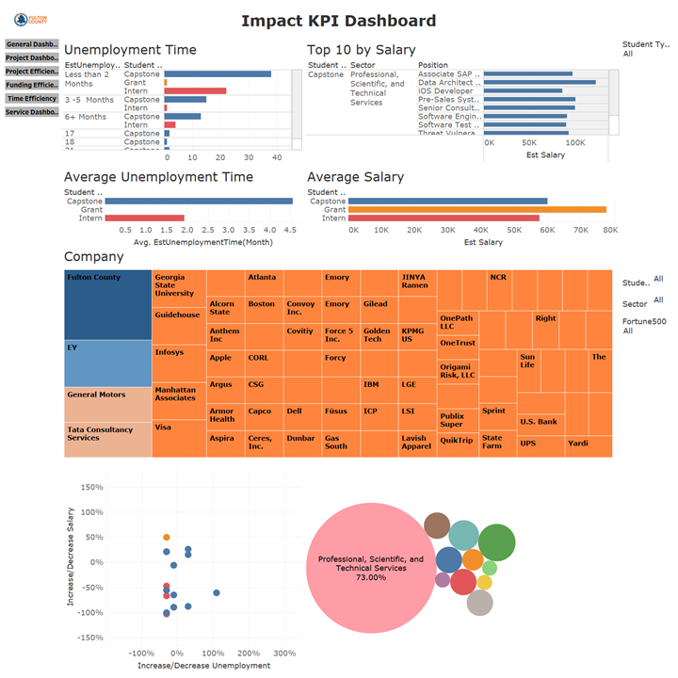
Impact KPI Visualization

Slide 13
CHALLENGES
How did we mitigate risk?
Exporting Data
Customer Support
We ran into issues exporting data from Trello.
Our team submitted support tickets to Atlassian and started a free trial of the paid version.
Engagement
Training Demonstrations
CHALLENGES
People enjoy using tools that are familiar to them.
Working sessions were organized and scheduled.
SOLUTIONS
Ambiguity
Project Plan Revisions
Our team had unclear strategy when our project launched.
We defined our roles and responsibilities in more detail.

Slide 14
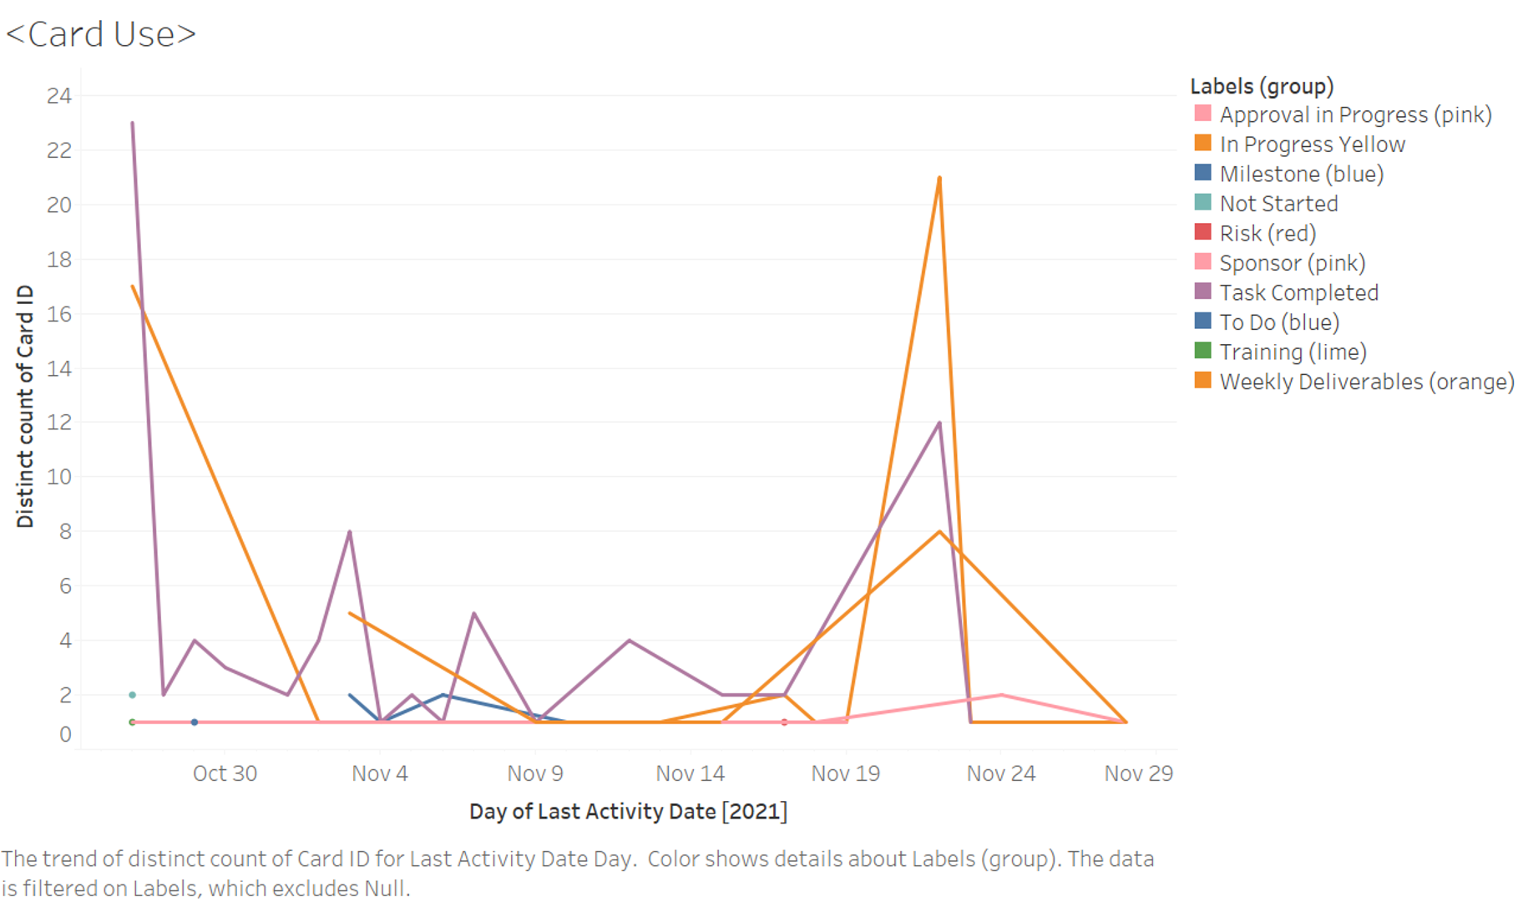
PROGRAM METRICS TRACKED
INSIGHTS EXTRACTED FROM EXPORTED TRELLO DATA
MARCH
APRIL
MAY
JUNE

Slide 15
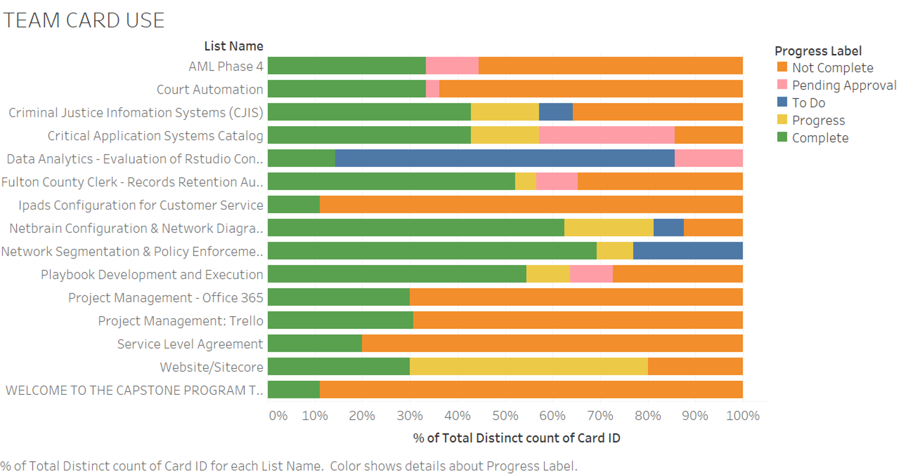
OUTCOME: TRELLO USAGE
EACH CAPSTONE TEAM’S TRELLO LABEL USAGE

Slide 16
FINAL OUTCOME EVALUATION
HOW DID WE QUANTIFY OUR SUCCESS?
NEW SURVEY DATA
Distribution of surveys to record impact
DATA LOSS REDUCTION
Securing existing and new data
TIMELINESS
Providing a quality solution on time
DOCUMENTED GUIDELINES
Easy to understand references for future interns

Slide 17
Learning Teamwork Strategy
Presenting at a High-Level
New Technological Skills
KEY PROJECT TAKEAWAYS
Workforce Preparation
Career Planning

Slide 18

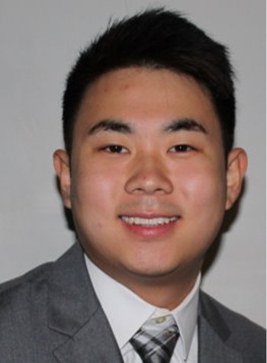
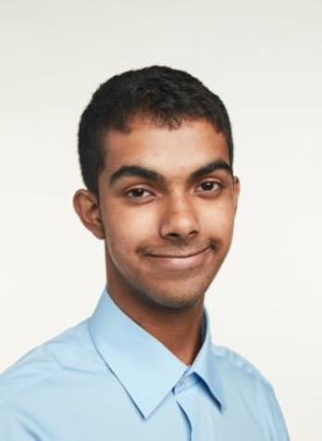
TEAM REFLECTION
INDIVIDUAL LESSONS LEARNED
ANGEL VO
TEAM LEAD
https://www.linkedin.com/in/angel-marie-vo/
Earned Google Data Studio Certification ★ Learned CRISP-DM Methodology, Qualtrics, New Team Development Skills ★ Enhanced Leadership, Analysis, & Public Speaking Abilities
DANIEL PARK
PROJECT PLAN TRACKER
https://www.linkedin.com/in/dpark28
Learned Tableau, Teamwork, Trello ★ Improved Public Speaking & Presenting, Coordinating Meetings, Excel ★ Creating a Detailed Project Plan
ADITYA BAGCHI
DATA SPECIALIST, TABLEAU
https://www.linkedin.com/in/aditya-bagchi-41177a162/
Learned Tableau, Zapier, Teamwork ★ Improved Microsoft Teams skill, Public Speaking

Slide 19
ANY QUESTIONS?

